Slide 1
Session 1, Introduction to Basic Java Web Application

Slide 2
Objectives
Introduction to java web application
+ The core and basic of Java web server technologies
+ Web design vs server technologies
Setup Environment :
JDK: 11 or higher
Servlet container: Tomcat 10.1
Intergrate Netbeans 13 with the web container.
Creating/Building the first application:
Learn to create Servlet
Learn to create JSP
Deploy the web application

Slide 3
What is HTML?
HTML is a language for describing web pages.
HTML stands for Hyper Text Markup Language
HTML is not a programming language, it is a markup language
A markup language is a set of markup tags
HTML uses markup tags to describe web pages

Slide 4
HTML Tags
HTML markup tags are usually called HTML tags
HTML tags are keywords surrounded by angle brackets like <html>
HTML tags normally come in pairs like <b> and </b>
The first tag in a pair is the start tag, the second tag is the end tag
Start and end tags are also called opening tags and closing tags.

Slide 5
HTML Documents = Web Pages
HTML documents describe web pages
HTML documents contain HTML tags and plain text
HTML documents are also called web pages

Slide 6
Web browser
The purpose of a web browser (like Internet Explorer or Firefox) is to read HTML documents and display them as web pages.
The browser does not display the HTML tags, but uses the tags to interpret the content of the page

Slide 7
Web page example
<html> <body> <h1>My First Heading</h1> <p>My first paragraph</p>
<a href=“http:\\cms.fpt.edu.vn”>Studying place</a> </body> </html>

Slide 8
What a Servlet is
Servlets are small Java programs that run on a Web server and help to build dynamic Web pages.
Servlets receive and respond to requests from Web clients, usually across HTTP, the HyperText Transfer Protocol.
Java Servlet technology was created as a portable way to provide dynamic, user-oriented content.

Slide 9
What a Servlet is...
Web
Server
Browser
Client
Request
Internet HTTP Protocol
Response
ServletContainer
Servlets
Database

Slide 10
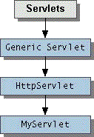
Architecture of the Servlet Package
The jakarta.servlet package provides interfaces and classes for writing servlets
When a servlet accepts a call from a client, it receives two objects:
ServletRequest, which encapsulates the communication from the client to the server.
ServletResponse, which encapsulates the communication from the servlet to the client.

Slide 11
HTTP Requests
An HTTP request consists of
a request method
a request URL
header fields
body.
HTTP 1.1 defines the following request methods:
GET - retrieves the resource identified by the request URL.
HEAD - returns the headers identified by the request URL.
POST - sends data of unlimited length to the web server.
PUT - stores a resource under the request URL.
DELETE - removes the resource identified by the request URL.
OPTIONS - returns the HTTP methods the server supports.
TRACE - returns the header fields sent with the TRACE request.

Slide 12
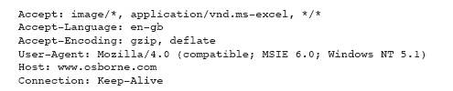
HTTP Request Sample

Slide 13
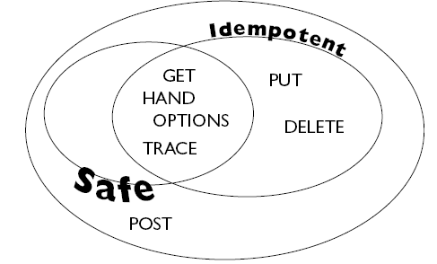
Idempotency and Safety Methods
https://stackoverflow.com/questions/45016234/what-is-idempotency-in-http-methods#45019073
Notes:
Idempotent: An idempotent request is meant to have the same result no
matter how many times it is executed. Request methods are considered "safe" if their defined semantics are essentially read-only

Slide 14
HTTP Responses
An HTTP response contains
a result code
header fields
a body
The HTTP protocol expects the result code and all header fields to be returned before any body content
Some commonly used status codes include:
404 - indicates that the requested resource is not available.
401 - indicates that the request requires HTTP authentication.
500 - indicates an error inside the HTTP server which prevented it from fulfilling the request.
503 - indicates that the HTTP server is temporarily overloaded, and unable to handle the request.

Slide 15
HTTP 1.1 Status Codes
Switching Protocols
Server will comply with Upgrade header and change to different protocol. (New in HTTP 1.1)
OK
Everything's fine; document follows for GET and POST requests. This is the default for servlets; if you don't use setStatus, you'll get this.
Created
Server created a document; the Location header indicates its URL.
202 Accepted
Request is being acted upon, but processing is not completed.
203 Non-Authoritative Information
Document is being returned normally, but some of the response headers might be incorrect since a document copy is being used.

Slide 16
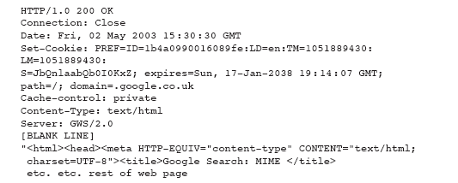
HTTP Response Sample

Slide 17
A Simple Servlet
import java.io.*;
import jakarta.servlet.*;
import jakarta.servlet.http.*;
public class FirstServlet extends HttpServlet {
public void doGet(HttpServletRequest request,
HttpServletResponse response)
throws ServletException, IOException
{
PrintWriter out = response.getWriter();
out.println(“<h1>First Servlet</h1>");
}
}

Slide 18
First Sevlet Demo
Demo\FirstServlet\WEB-INF\classes\FirstServlet.java

Slide 19
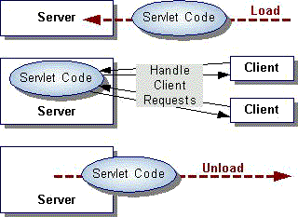
The Servlet Life Cycle
init
service
destroy

Slide 20
HttpServlet Class
The protocol defines a set of text-based request messages called HTTP ‘methods’ implemented in HttpServlet class:
doGet Called by the server (via the service method)to allow a servlet to handle a GET request
doHead Receives an HTTP HEAD request from the protected service method and handles the request
doPost called by the server to allow a servlet to handle post request
doPut Called by the server (via the service method) to allow a servlet to handle a PUT request
doDelete Called by the server (via the service method) to allow a servlet to handle a DELETE request
doTrace Called by the server (via the service method) to allow a servlet to handle a TRACE request
doOptions Called by the server (via the service method) to allow a servlet to handle a OPTIONS request

Slide 21
Request Headers
It can also send a number of headers:
Accept The MIME types the browser prefers.
Accept-Charset The character set the browser expects.
Content-Length (for POST messages, how much data is attached)
Connection Use persistent connection? If a servlet gets a Keep-Alive.
Cookie (one of the most important headers)
Host (host and port as listed in the original URL)
If-Modified-Since (only return documents newer than this)
Referer (the URL of the page containing the link the user followed to get to current page)

Slide 22
Request Headers…
import javax.servlet.*;
import java.io.*;
import javax.servlet.http.*;
import java.util.*;
public class ShowRequestHeaders extends HttpServlet {
public void doGet(HttpServletRequest request,HttpServletResponse response) throws ServletException, IOException
{
response.setContentType("text/html");
PrintWriter out = response.getWriter();
Enumeration headerNames = request.getHeaderNames();
out.println("<TABLE>");
while(headerNames.hasMoreElements()) {
String headerName = (String)headerNames.nextElement();
out.println("<TR><TD>" + headerName+"</TD>");
out.println("<TD>" + request.getHeader(headerName)+"</TD></TR>");
}
out.println("</TABLE>");
}
}

Slide 23
Show Request Header Demo
Demo\FirstServlet\WEB-INF\classes\ShowRequestHeaders.java

Slide 24
HTTP Response
When a Web server responds to a request from Web client, the response typically consists of a status line, some response headers, a blank line, and the document:
HTTP/1.1 200 OK status line
Content-Type: text/plain response header
blank line
Welcome to Servlets World the document
Status line:
HTTP version
An integer that is interpreted as a status code
A very short message corresponding to the status code.
In most cases, all of the headers are optional except for Content-Type, which specifies the MIME type of the document that follows

Slide 25
HTML Form
A form is an area that can contain form elements.
Form elements are elements that allow the user to enter information (like text fields, textarea fields, drop-down menus, radio buttons, checkboxes, etc.) in a form.

Slide 26

HTML Form Inputs
Text fileds
<html>
<body>
<form> First name: <input type="text" name="firstname" /> <br /> Last name: <input type="text" name="lastname" /> </form>
</body>
<html>
How it looks in a browser:

Slide 27

HTML Form Inputs..
Radio Buttons:
<html>
<body>
<form>
<input type="radio" name="sex" value="male" /> Male
<br />
<input type="radio" name="sex" value="female" /> Female
</form>
</body>
<html>
How it looks in a browser:

Slide 28
The Form's Action Attribute and the Submit Button
When the user clicks on the "Submit" button, the content of the form is sent to the server. The form's action attribute defines the name of the file to send the content to. The file defined in the action attribute usually does something with the received input.

Slide 29
The Form's Action Attribute and the Submit Button…
<html>
<body>
<form name="input" action="/LoginServlet" method="post">
<table>
<tr>
<td>User name:</td><td><input type="text" name="user"/></td>
</tr>
<tr>
<td>Password:</td><td><input type="password" name="pass"/></td>
</tr>
<tr>
<td></td><td><input type="submit" value="Login"/></td>
</tr>
</table>
</form>
</body>
<html>

Slide 30
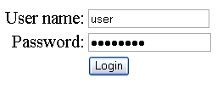
The Form's Action Attribute and the Submit Button…

Slide 31
Form Data
Call getParameter method of the HttpServletRequest, supplying the parameter name as an argument
public void doPost(HttpServletRequest request, HttpServletResponse response)
throws ServletException, IOException
{
//get form data
String u =request.getParameter("user");
String p=request.getParameter("pass");
response.setContentType("text/html");
PrintWriter out = response.getWriter();
out.println("<html><body>");
out.println("<h1>You sent me:</h1>");
out.println(u+"<br>"+p);
out.println("</body></html>");
}

Slide 32
Web application
A web application or webapp is an application that is accessed via web browser over a network such as the Internet or an intranet. It is also a computer software application that is coded in a browser-supported language (such as HTML, JavaScript, Java, etc.) and reliant on a common web browser to render the application executable.
Web applications are popular due to the ubiquity of web browsers, and the convenience of using a web browser as a client, sometimes called a thin client.

Slide 33
File and Directory Structure
A Place for Everything and Everything in Its Place.
Construct the file and directory structure of a Web Application that may contain:
static content,
JSP pages,
servlet classes,
the deployment descriptor,
tag libraries,
JAR files and Java class files;
and describe how to protect resource fi les from HTTP access.

Slide 34
Special Directories Beneath the Context Root
/WEB-INF/classes—for classes that exist as separate Java classes (not packaged within JAR files). These might be servlets or other support classes.
/WEB-INF/ lib—for JAR fi les. These can contain anything at all—the main servlets for your application, supporting classes that connect to databases—whatever.
/ WEB-INF itself is the home for an absolutely crucial file called web.xml, the deployment descriptor file.

Slide 35
Deployment Descriptor Elements
The first thing to note about the deployment descriptor file is that it’s an XML file. Given that the name is web.xml.

Slide 36
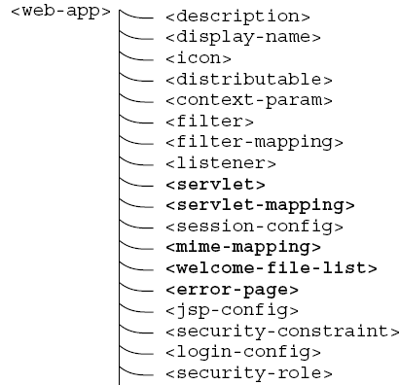
Overall Structure of the Deployment Descriptor.
Notes:
MINE-Multi-purpose Internet Mail Extensions

Slide 37
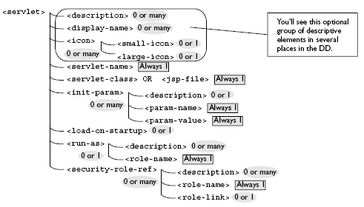
<servlet> and Its Important Subelements

Slide 38
Deployment Descriptor simple web.xml
<?xml version="1.0" encoding="ISO-8859-1"?>
<web-app xmlns="http://java.sun.com/xml/ns/j2ee"
xmlns:xsi="http://www.w3.org/2001/XMLSchema-instance"
xsi:schemaLocation=http://java.sun.com/xml/ns/j2ee http://java.sun.com/xml/ns/j2ee/web-app_2_4.xsd version="2.4">
<display-name>Servlet 2.4 Examples</display-name>
<description>
Servlet 2.4 Examples.
</description>
<!-- Define servlets that are included in the example application -->
<servlet>
<servlet-name>FirstServlet</servlet-name>
<servlet-class>FirstServlet</servlet-class>
</servlet>
<servlet-mapping>
<servlet-name>FirstServlet</servlet-name>
<url-pattern>/FirstServlet</url-pattern>
</servlet-mapping>
</web-app>

Slide 39
Welcome Files
<welcome-file-list>
<welcome-file>index.html</welcome-file>
<welcome-file>index.jsp</welcome-file>
<welcome-file>mainlibrary/catalog.jsp</welcome-file>
</welcome-file-list>

Slide 40
Packaging Your Web Application
A WAR Is Not a JAR
Although a WAR fi le can be produced in the same way as a JAR fi le, and has the same underlying fi le format, it is different. The most obvious difference is the file extension naming convention: .jar for Java ARchive, and .war for Web (Application) ARchive.
WARs are packaged for a different purpose: to make it as easy as possible for a web container to deploy an application.

Slide 41
WAR file
Several web containers have automatic deployment mechanisms.
The server recommended for this course—Tomcat 7.x or Glassfish 4.x—has a “webapps” directory.
Place a WAR file in this directory, and Tomcat (by default) will un-jar the contents into the file system under the webapps directory.
a context root directory is the same name as the WAR file (but without the .war extension)— then makes the application available for use.

Slide 42
War file demo
Demo\WarFile\FirstServlet.war

Slide 43
Classwork 1
Create a simple Web application that prints out a welcome message based on user’s input in form of url parameters.
E.g.: http://localhost:8080/first-app/welcome?name=John&color=blue

Slide 44
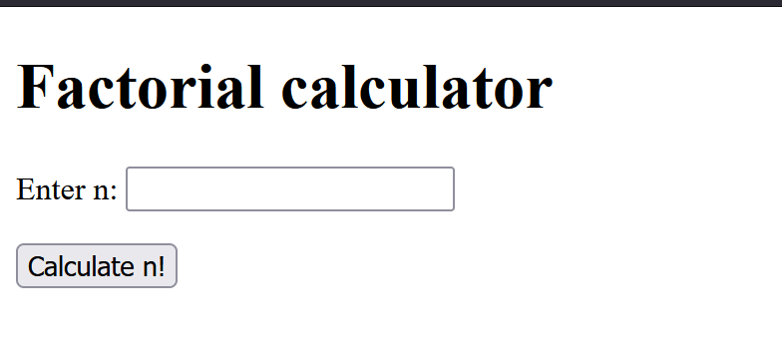
Classwork 2
URL pattern: /WelcomeApp/factorial.jsp
In your /factorial.jsp
Constrains: 1 < n < 21
If entered n is not a number or violates constrain, output an error, otherwise, do the math.

Slide 45
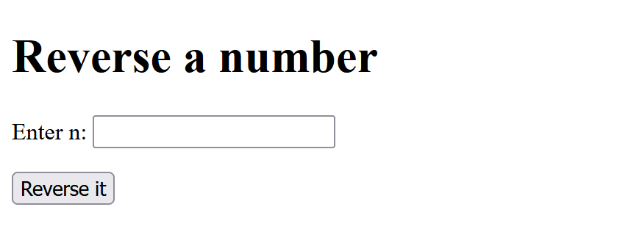
Classwork 3
URL pattern: /WelcomeApp/reverse-num
In your /index.html
Constrain:
99 < n < 1000
If entered n is not a (3-digit) number, output an error.
Otherwise, reverse n.
Test case: n = 456, reversed n = 654.

Slide 46
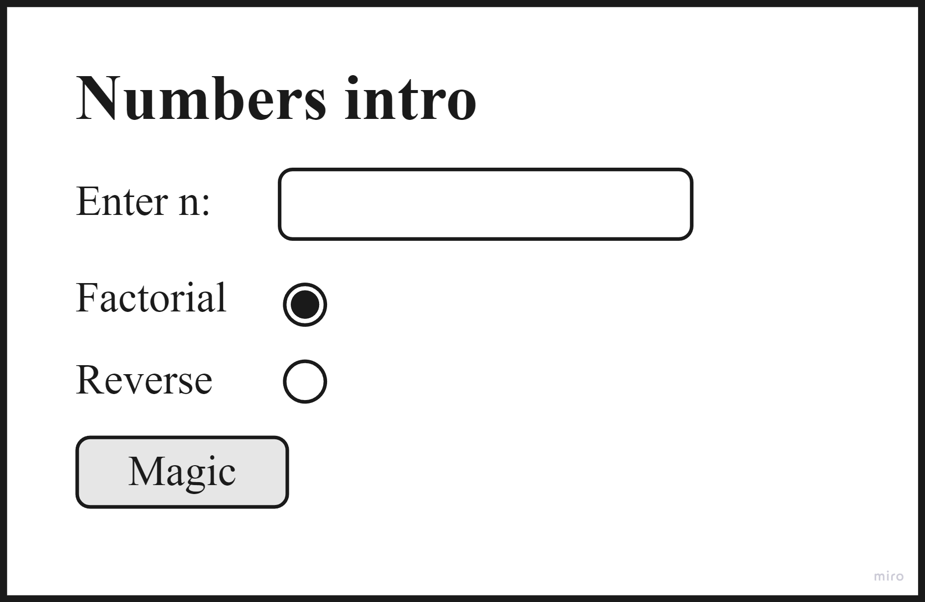
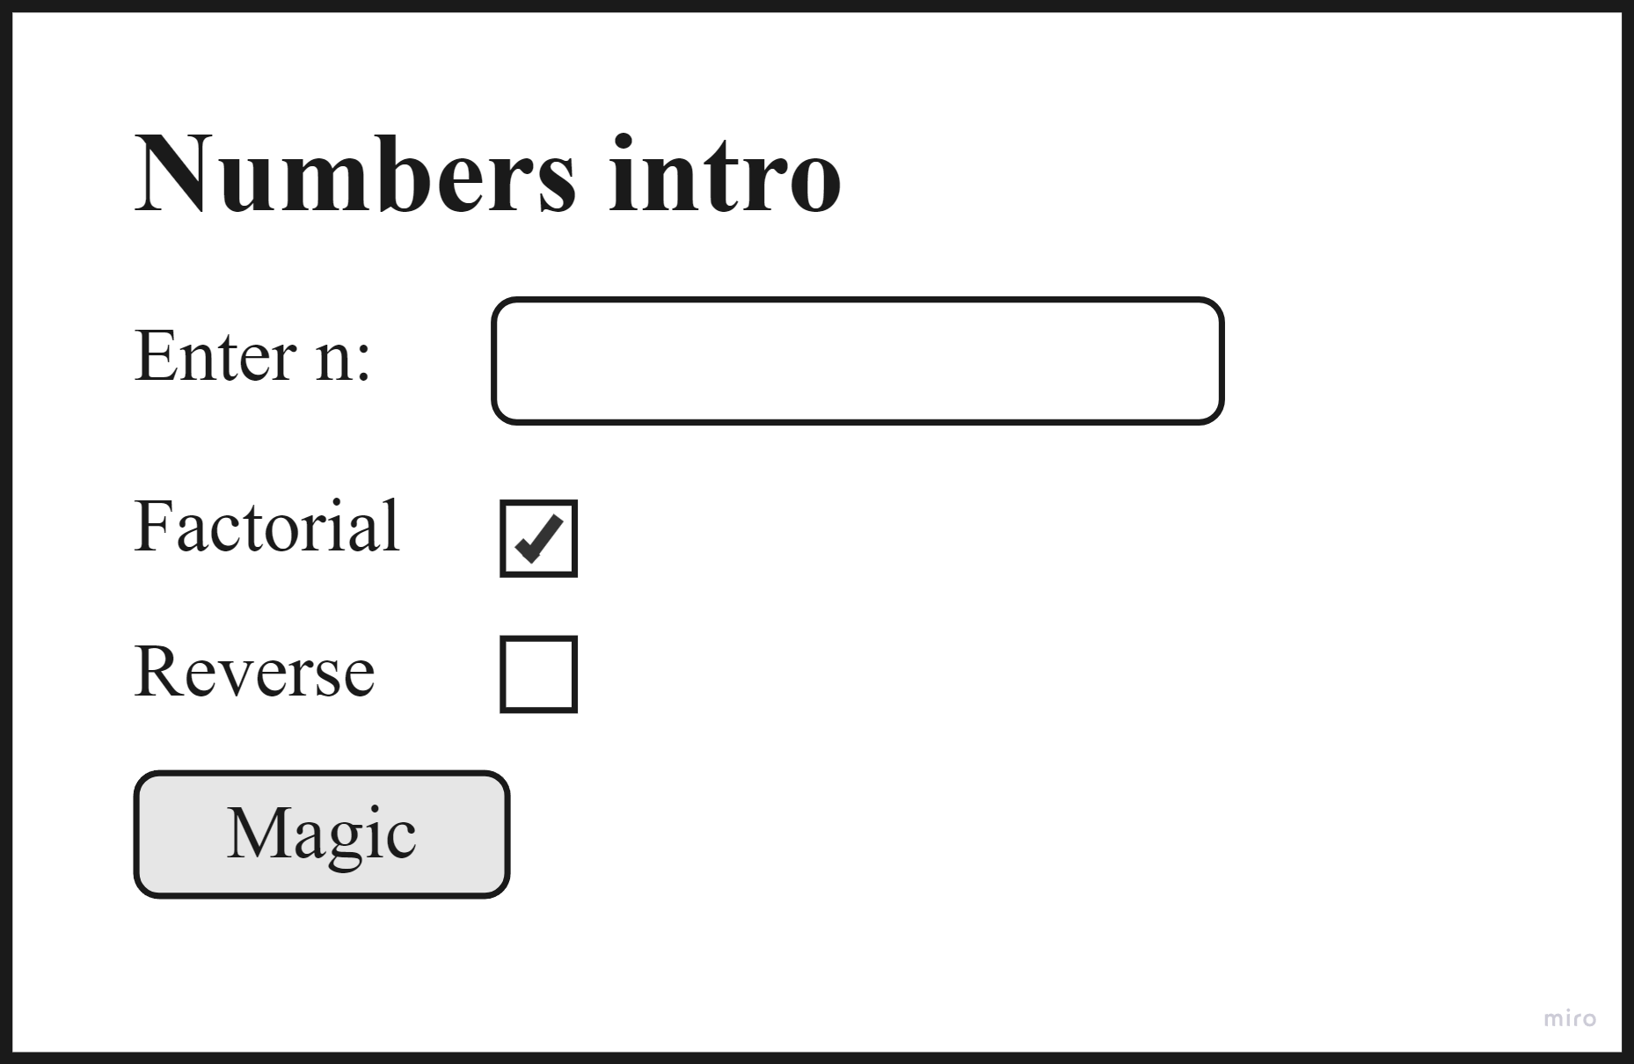
Classwork 4
URL pattern (where the form sends request to): /WelcomeApp/magic
In your /numbers.jsp
Combine both
classwork.

Slide 47
Summary
HTML Introduction
What is HTML?
HTML Tags
HTML Documents = Web Pages
Web browser
Example
Servlets
What a Servlet is and how you can use one.
How to define and write servlets.
Basic Servlet Structure.
Request / Response Headers.
Handling Form Data.
Java Servlet Specification
Jakarta-tomcat-7.x or Glassfish 4.x
Web application
File and Directory Structure
Deployment Descriptor Elements
WAR Files

